Slide 1
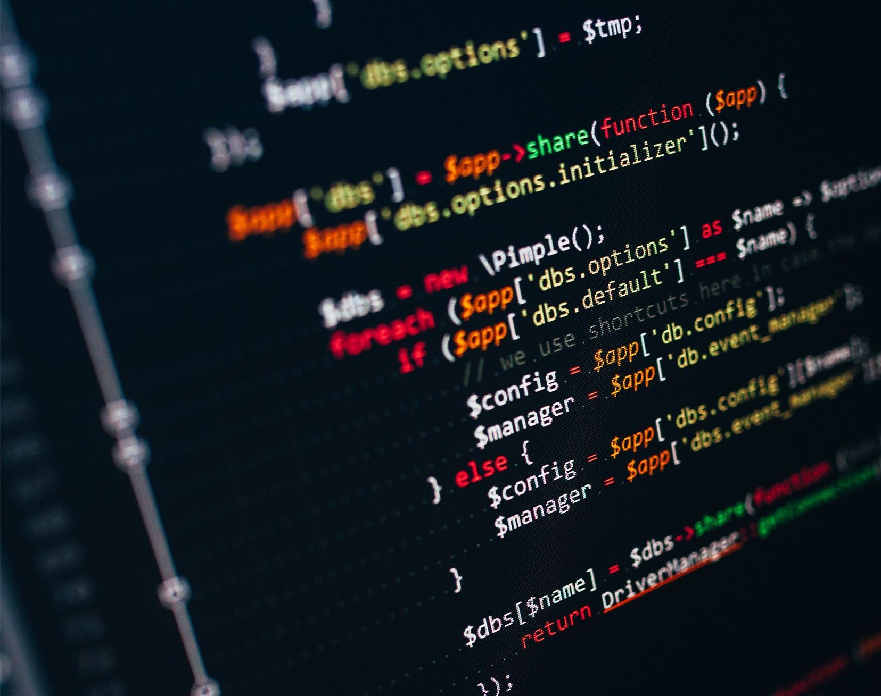

GameSAT
Play to learn.

Slide 2
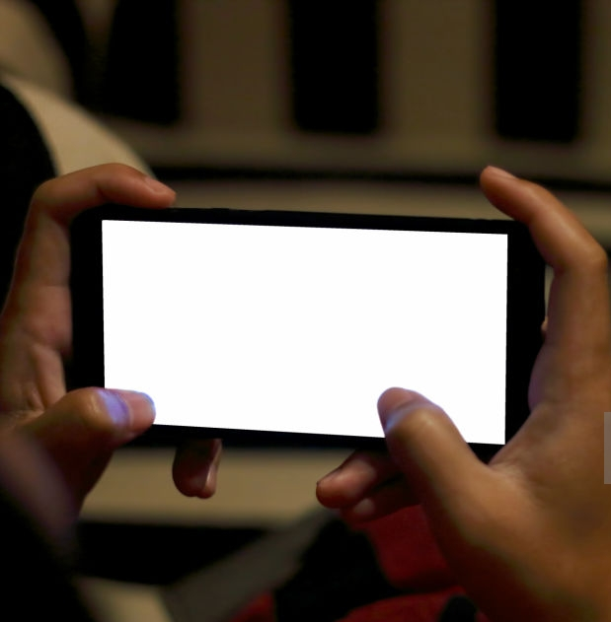
Overall Project

Slide 3

Progress
Designed a database with remote capabilities to store user data.
Implemented app functionalities that gather and use user data.
Implemented app functionalities that allow the user to navigate into the play/train options.

Slide 4
Challenges
Connecting the Login Register with XAMPP
Configuring the Android Studio Enumerator
Proper set up of Android Studio with GitHub.

Slide 5
What's functionalities are left?
Create a database of word and passage questions.
Import the questions into the app.
Allow the app to time questions in play mode, and maintain scores.
Allow the app to move to new levels, and determine game ending conditions.
What Functionalities Remain?

Slide 6

Remaining Functionalities
Keep Track of Levels.
Keep track of a Global Scoreboard.
Decrement time as levels increase.

Slide 7

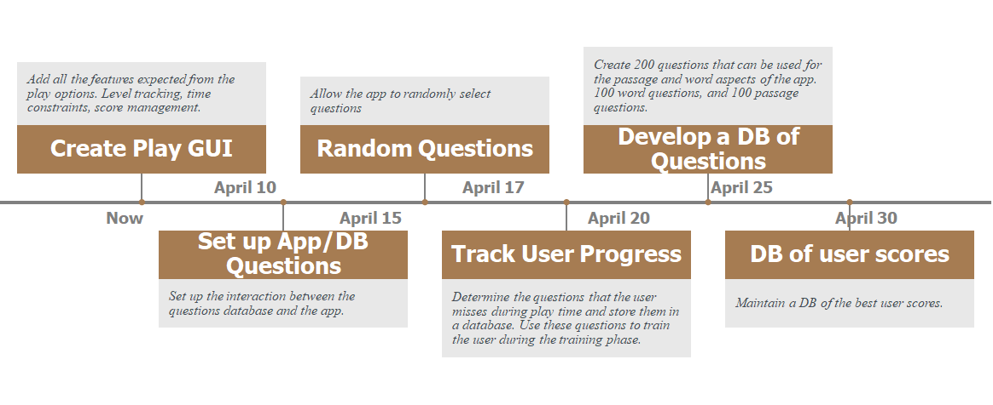
TimeLine

Slide 8
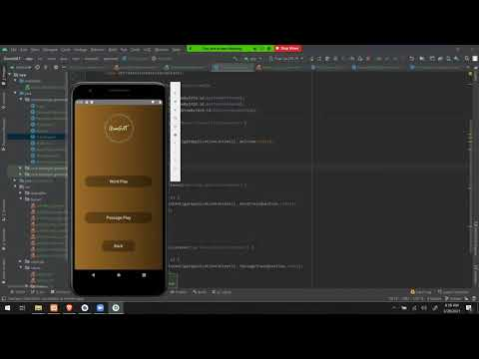
Demo

Slide 9

Implementation
Android Studio
Java
MySQL
Project Management:
Trello

Slide 10
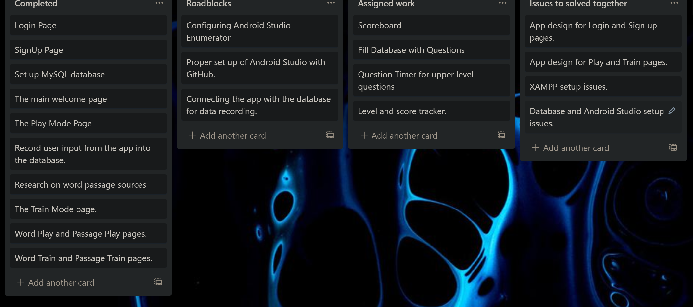

Project Management

Slide 11
References
https://github.com/VishnuSivadasVS/Advanced-HttpURLConnection
https://www.majortests.com/gre/wordlist.php
https://www.youtube.com/watch?v=X8oD4q3XtQQ

Slide 12

Thank You

